Slide 1
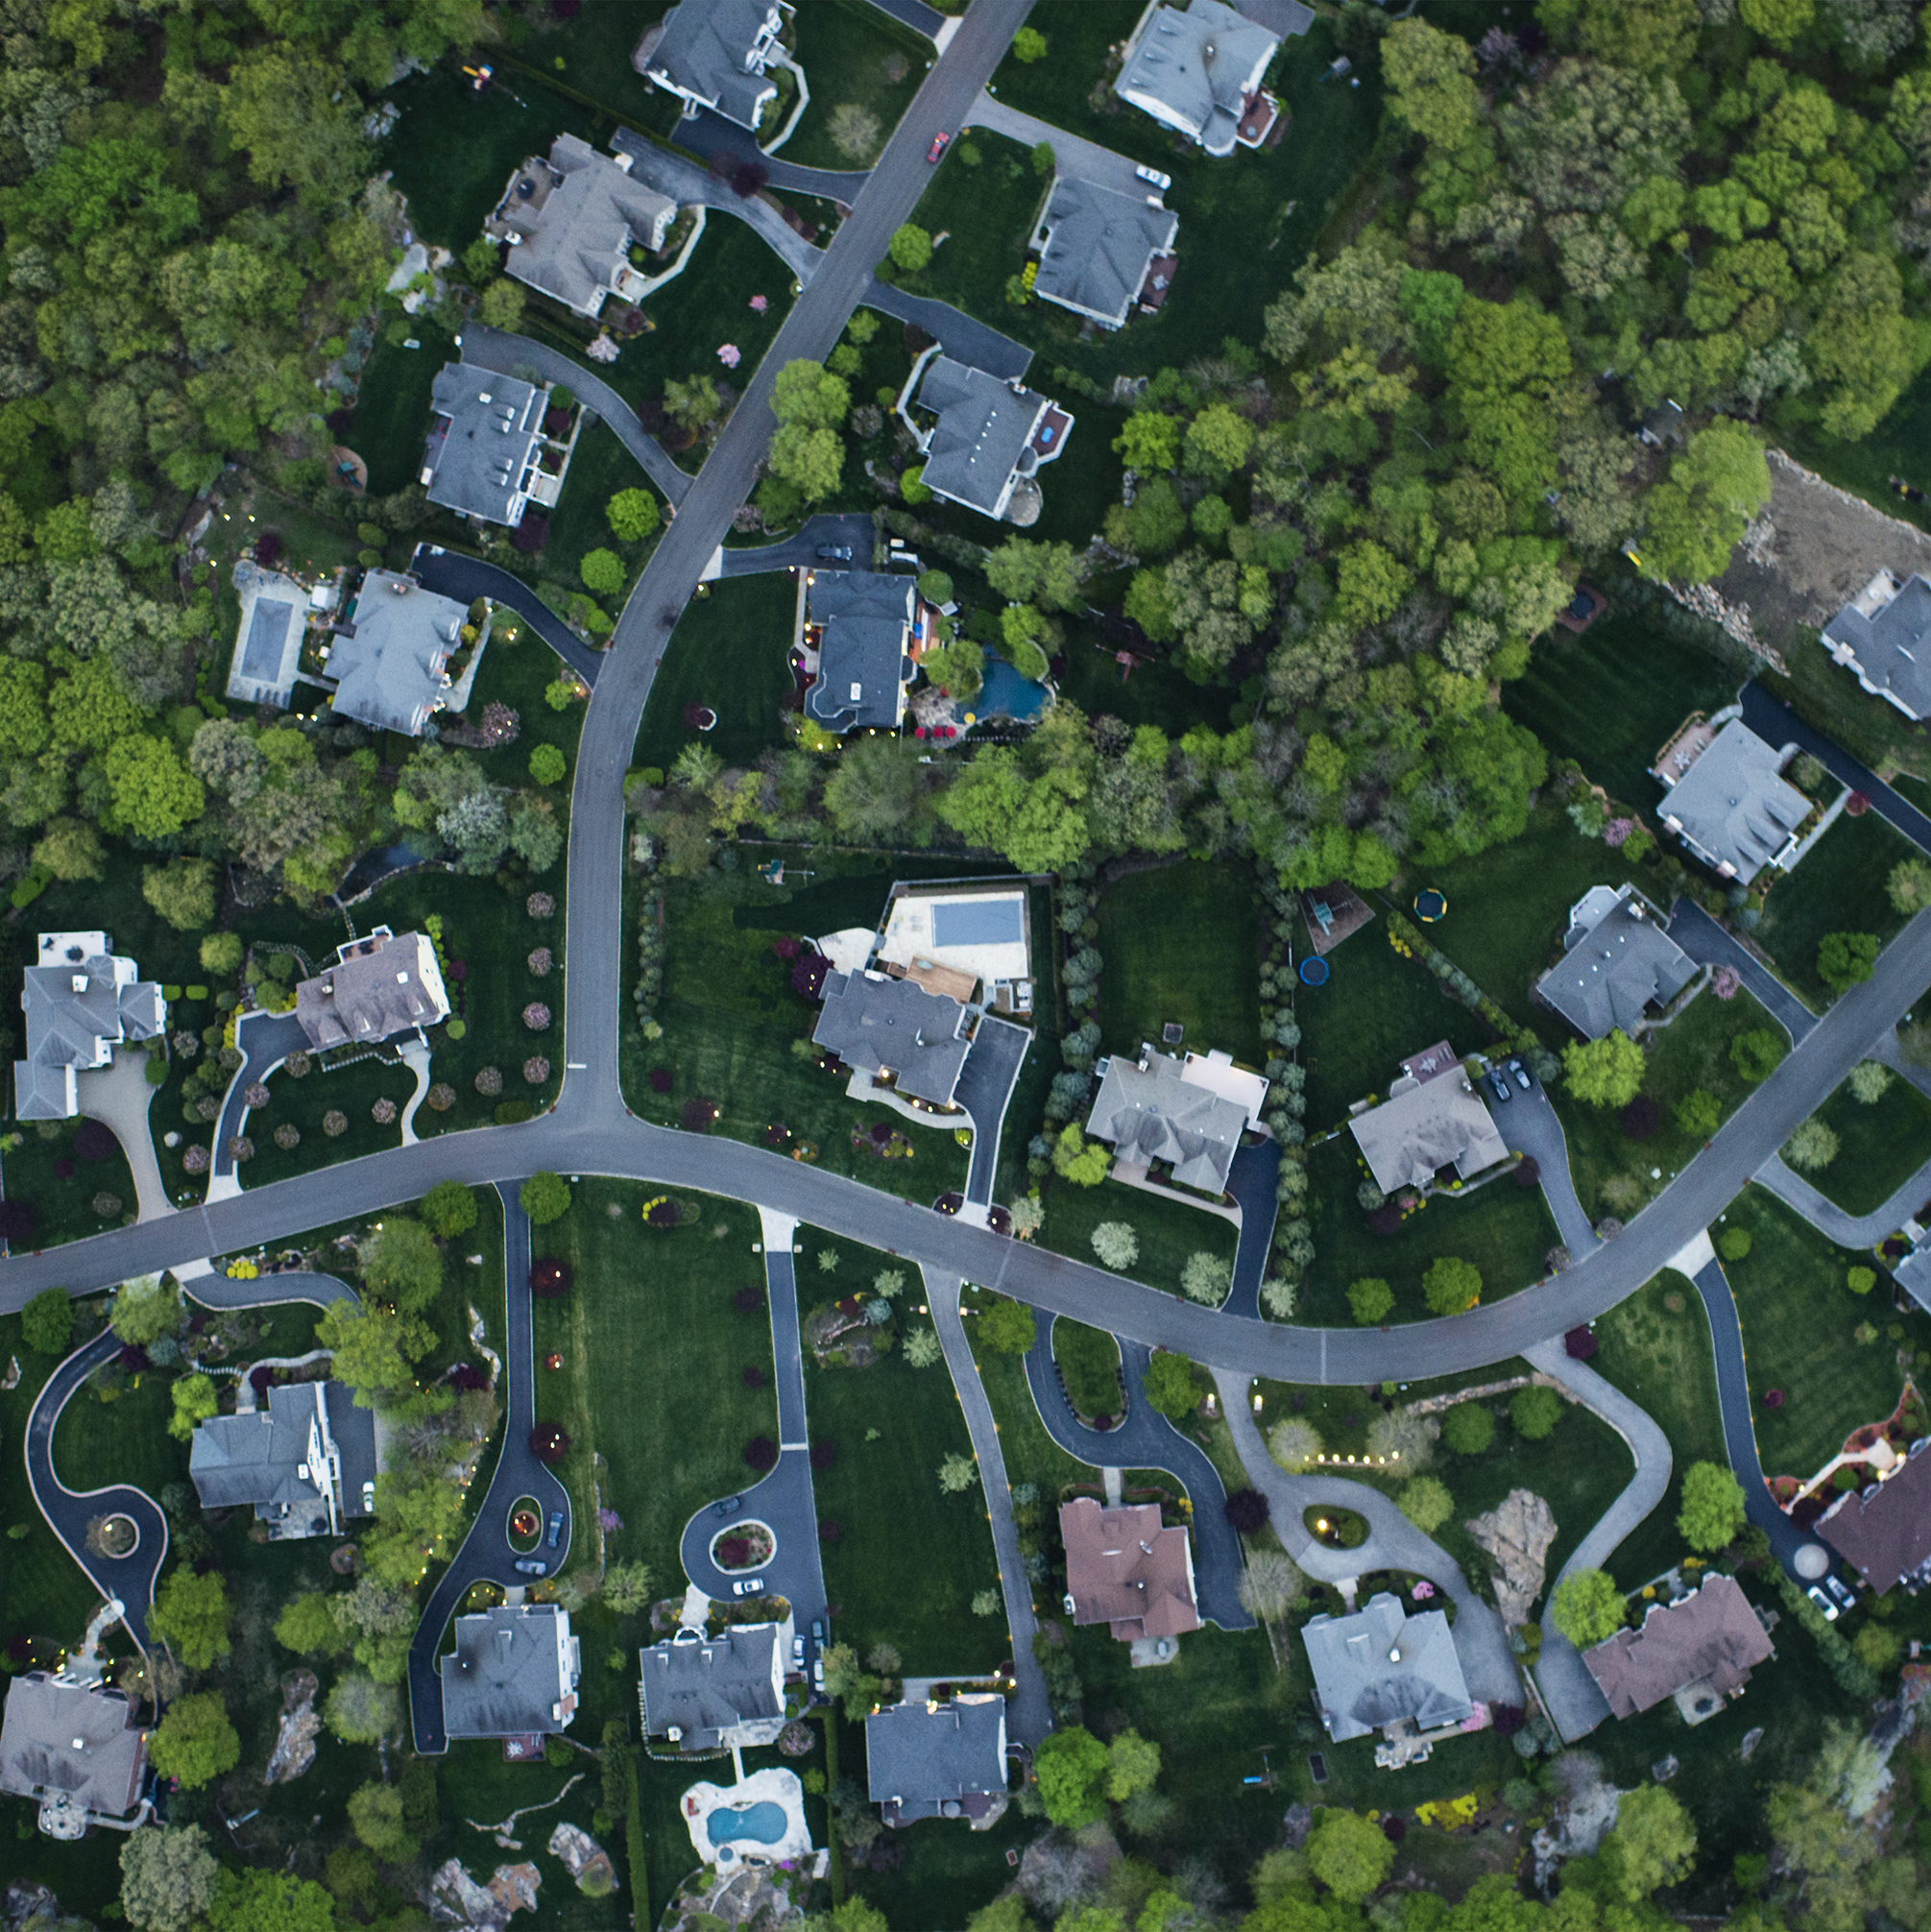
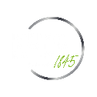
Home in the Outback: Predicting Housing Prices in Australia Andrew Yang
January 2023

Slide 2
1
Business Understanding
2
Business Problem
3
Features
6
Conclusion
5
Modelling & Evaluation
4
Data Understanding

Slide 3
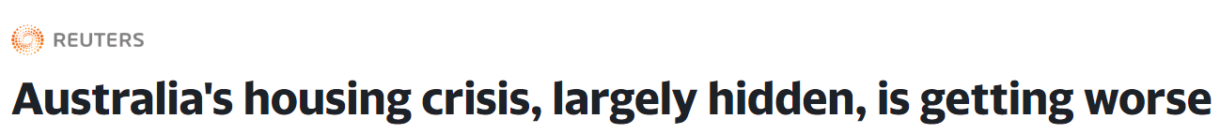
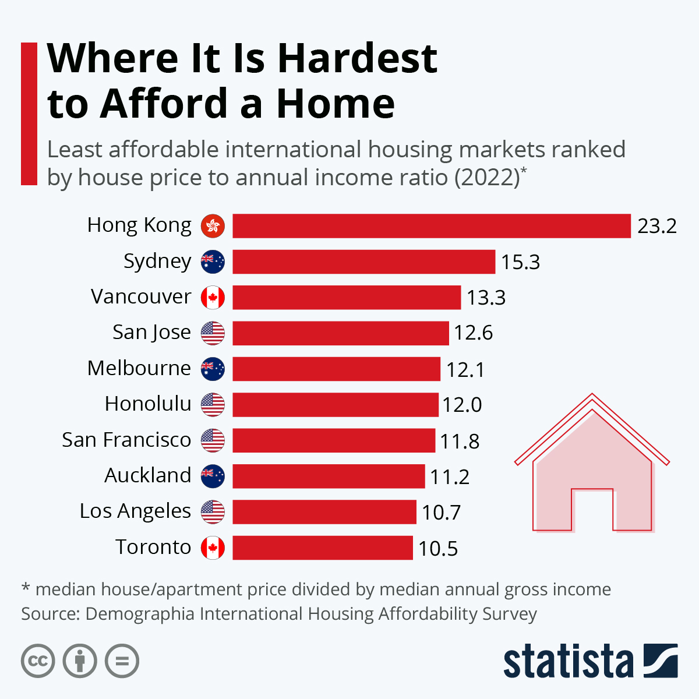
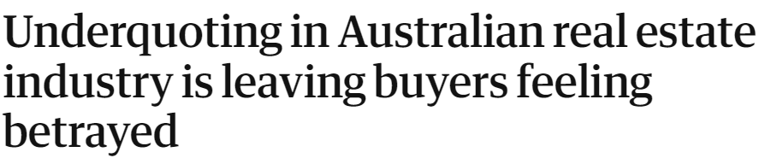
Business Understanding
“It’s misleading, it’s a fraud on purchasers. And until significant penalties are handed out, regulations have been ineffective … if one does it, others have to follow.”
- David Morrel, buyer’s advocate
Notes:
Australia’s housing crisis, largely hidden, is getting worse
https://finance.yahoo.com/news/australias-housing-crisis-largely-hidden-070415119.html?guccounter=1&guce_referrer=aHR0cHM6Ly93d3cuZ29vZ2xlLmNvbS8&guce_referrer_sig=AQAAAIeblSi7VEKUODbNCb9V4JDKGXyZJvlZsU_59oHV11iTLIA7Hz_-1hB6AIFjgR0hweoHP6PmFcHpz2DsQSW68EBJh7Ca8uaCkOsTQEnCZbUC_LqUkeBKCa_tS8VV1wWzrZfa3WtiOzj0sOeX1ZC88oJINHwQ2SiuGTf3YaZd73kv
Statistia chart:
https://www.statista.com/chart/16902/places-where-its-hardest-to-afford-a-home/
Underquoting article title: https://www.theguardian.com/business/2022/aug/27/underquoting-in-australian-real-estate-industry-is-leaving-buyers-feeling-betrayed
POINTS TO COVER:
Australian citizens have difficulty finding housing.
Historically, Australia has had issues with housing affordability, seeing rising real estate prices over the past decade(s) or so.
This has made many Australian cities some of the least affordable places in the world.
Additionally, the real estate industry in Australia has rampant underquoting, which is to the detremient of buyers.
They go out and look at these properties, but eventually find out that the true value is beyond their price point.
By using a model, a buyer can look at the characteristics of a property in a listing and estimate the true price; better informed, find properties at a discount, find properties that fit their requirements

Slide 4
Business Problem
Problem Potential buyers are having difficulties buying or renting Australian properties. Affordability issues Historical trend of rising prices Rampant underquoting
Objective Develop a model for these potential homeowners that: Determines the true price of a property Aids in locating homes that fit the requirements of the seller Figures out which homes are sold at a discount

Slide 5
Features
1 Building Size
2 Land Size
3 Bedrooms
4 Bathrooms
5 Parking Spaces
6 Property Type
7 Product Depth
Notes:
Dataset – 1000 house listings publically available from Kaggle
After cleaning process – approximately 800 observations
Cleaning (land and building size, price)
Imputation of land, building, price according to property type
Preprocessing (scaling data + encoding property type and product depth)

Slide 6
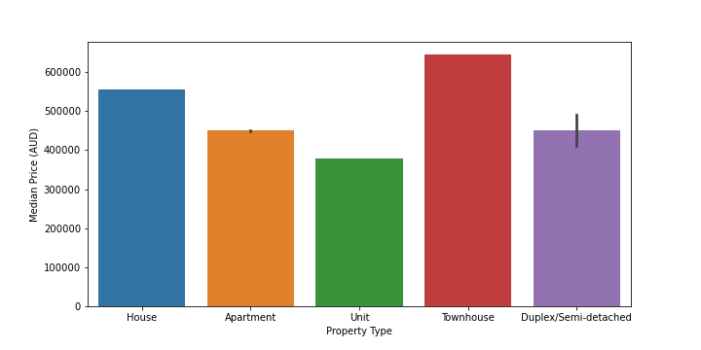
Data Understanding
Figure 1: Median housing prices by property type.

Slide 7
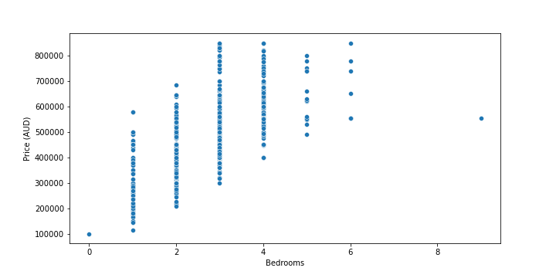
Data Understanding
Figure 2: Housing prices over number of bedrooms.

Slide 8
Data Understanding
 | Median | IQR
Building Size (m²) | 147 | 103
Land Size (m²) | 294.5 | 650
Bedrooms | 3 | 1
Bathrooms | 2 | 1
Parking Spaces | 2 | 1
Price (AUD) | 485,000 | 177,500
Table 1: Descriptive statistics of features and target.
Notes:
Other statistics:
Most prevalent housing types: houses, units (375, 221)
Most prevalent product depth (variant): premiere (563)

Slide 9
Modeling & Evaluation
Model | RSME (AUD)
Baseline | 124,670.31
Decision Tree | 94,997.47
Gradient Boosting | 87,969.37
Gradient Boosting (subsampled) | 85,967.02
Table 2: Comparison of model test performance.

Slide 10
Conclusion
On average, the best model predicts the true value of Australian housing within 85,967.02 AUD.
This is an approximately 31% improvement in performance compared to the baseline.
Limitations
Future Improvements
Listing data is subject to underquoting.
Small public dataset (1000 listings)
Inability to implement geographic information.
Use sold housing data for true property value.
Implement neural networks on a larger dataset.
Investigate the effects listing agencies have on pricing.

